Slide 1

Data Review

Slide 2
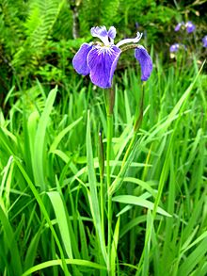
Basic Data
 | 0 | 1 | 2 | 3 | 4
0 | 5.1 | 3.5 | 1.4 | 0.2 | Iris-setosa
1 | 4.9 | 3 | 1.4 | 0.2 | Iris-setosa
2 | 4.7 | 3.2 | 1.3 | 0.2 | Iris-setosa
3 | 4.6 | 3.1 | 1.5 | 0.2 | Iris-setosa
4 | 5 | 3.6 | 1.4 | 0.2 | Iris-setosa

Slide 3
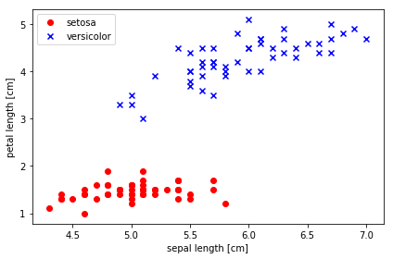
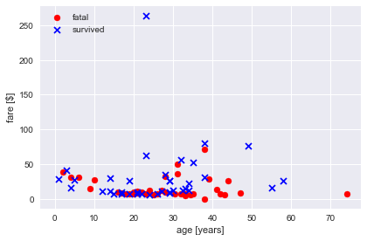
Convergence Limitations

Slide 4
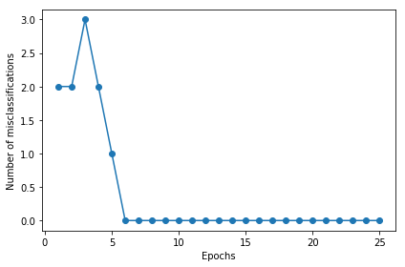
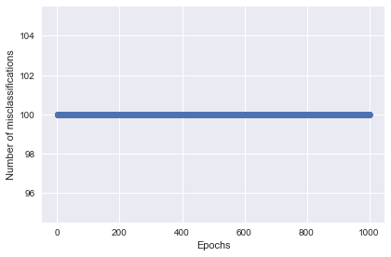
Convergence Limitations (cont.)

